Slide 1
Unit 8. LL(k) grammars

Slide 2
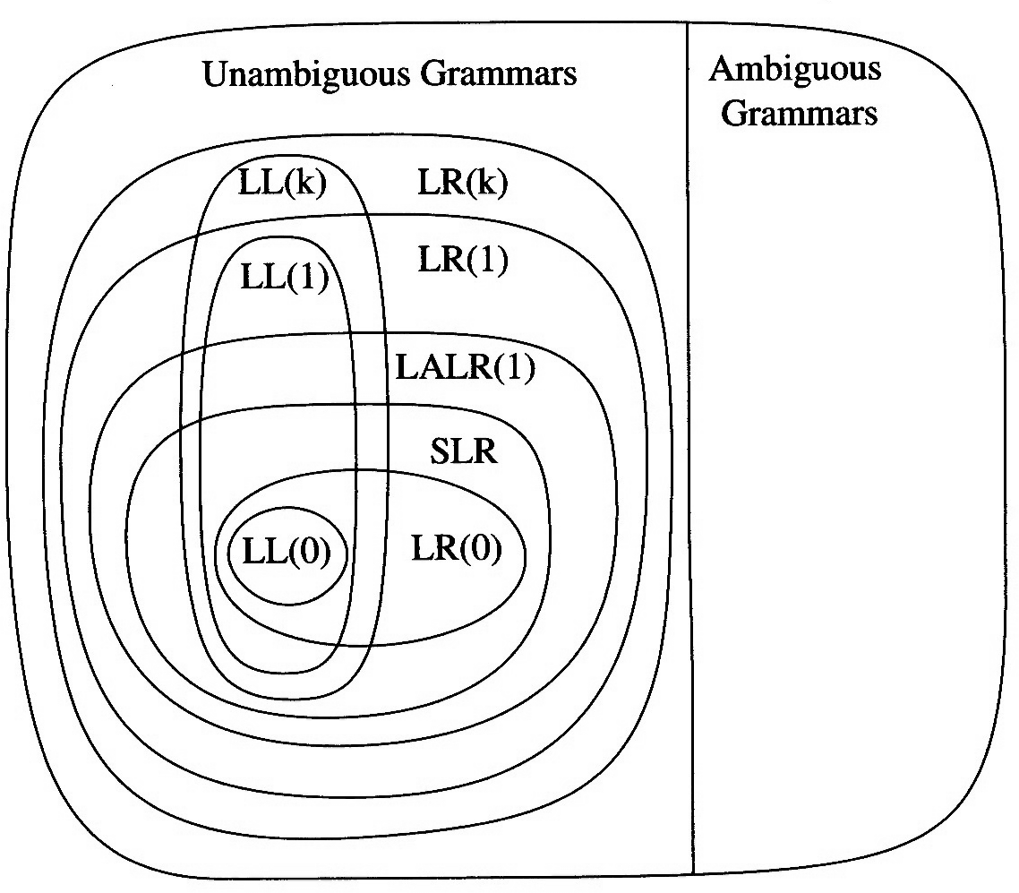
Hierarchy of grammar classes

Slide 3
LL(k) grammar
What is LL(k)?
The first L stands for scanning the input from left to right,
the second L stands for producing a leftmost derivation,
And k stands for using k input symbols of lookahead at each step to make parsing action decision.

Slide 4
LL(k) Grammar
Subset of CFG’s
Permits deterministic left-to-right recognition with a look ahead of k symbols
Builds the parse tree top-down
If the correct production can be deduced from the partially constructed tree and the next k symbols in the unscanned string, for every possible step, then the grammar is said to be LL(k)
If a parse table can be constructed for the grammar, then it is LL(k), if it can’t, it is not LL(k)

Slide 5
LL(k) Grammars
An LL(k) grammar has the property that a parser can be constructed to scan an input string from left to right and build a leftmost derivation by examining next k input symbols to determine the unique production for each derivation step.
If a language has an LL(k) grammar, it is called an LL(k) language.
LL(k) languages are deterministic context-free languages, but there are deterministic context-free languages that are not LL(k)

Slide 6
How to Build Parse Tables? FIRST and FOLLOW Sets
For a string of grammar symbols α define FIRST(α) as
The set of tokens that appear as the first symbol in some string that derives from α
If α ⇒* ε, then ε is in FIRST(α)
For a non-terminal symbol A, define FOLLOW(A) as
The set of terminal symbols that can appear immediately to the right of A in some sentential form

Slide 7
FIRST Set Construction
To construct FIRST(X) for a grammar symbol X, apply the following rules until no more symbols can be added to FIRST(X)
If X is a terminal FIRST(X) is {X}
If X →ε is a production then ε is in FIRST(X)
If X is a nonterminal and X →Y₁Y₂ ... Y_{k} is a production then put every symbol in FIRST(Y₁) other than ε to FIRST(X)
If X is a nonterminal and X →Y₁Y₂ ... Y_{k} is a production, then put terminal a in FIRST(X) if a is in FIRST(Y_{i}) and ε is in FIRST(Y_{j}) for all 1 ≤ j < i
If X is a nonterminal and X →Y₁Y₂ ... Y_{k} is a production, then put ε in FIRST(X) if ε is in FIRST(Y_{i}) for all 1 ≤ i ≤ k

Slide 8
Computing FIRST Sets for Strings of Symbols
To construct the FIRST set for any string of grammar symbols X₁X₂ ... X_{k} (given the FIRST sets for symbols X₁ , X₂ , ... X_{k} ) apply the following rules.
FIRST(X₁X₂ ... X_{k} ) contains:
Any symbol in FIRST(X₁) other than ε
Any symbol in FIRST(X_{i}) other than ε, if ε is in FIRST(X_{j}) for all 1 ≤ j < i
ε , if ε is in FIRST(X_{j}) for all 1 ≤ i ≤ n

Slide 9
FIRSTk(α)
Description: Given a CFG, k is a natural number, α contains both terminals and nonterminals.
FIRST_{k}(α)consists of all terminal prefixes of length k (or less if α derives a terminal string of lengh less than k) of terminal strings that can be derived from α
Definition: Given grammar G= (Σ, Δ, P, S), natural number k , α ∈ V*
FIRSTk(α) =
{ x ∈ Σ* | α ⇨ xβ and |x| = k or α ⇨ x and |x| < k}

Slide 10
FOLLOW_{k}(α)
includes the set of terminal strings that can occur immediately to the right of α in any sentential form
Especially, if α is nonterminal A and βA is a sentential form then ε is in FOLLOW₁(A).

Slide 11
FOLLOW_{k}(α)
FOLLOW_{k}(α) =
{x ∈ Σ* | S ⇒* βαδ and x∈ FIRST_{k}(δ)}
Especially, if α =A ∈ Δ* , S ⇒* βA then FOLLOW₁(A) ={ε} or FOLLOW₁(A) ={$} (EOF)
FOLLOW(A) is FOLLOW₁(A)

Slide 12
LL(k) Grammars
Definition Let G = (Σ, Δ, P, S) is a CFG and k ∈N. G is LL(k) if for any two leftmost derivations
S => xAα => xβ₁α => xZ₁
S => xAα => xβ₂α => xZ₂
if FIRST_{k}(Z₁) = FIRST_{k}(Z₂) then β₁ = β₂
It can be shown that LL(k) grammars are not ambiguous and not left-recursive.

Slide 13
Example
Grammar G :
S → aSb | ab
is not LL(1), but is LL(2)

Slide 14
Simple LL(1) Grammars
For simple LL(1) grammars all rules have the form
A→ a₁α₁ | a₂α₂ | … | a_{n}α_{n}
where
a_{i} is a terminal, 1 ≤ i ≤ n
a_{i} ≠ a_{j} for i ≠ j and
α_{i} is a sequence of terminals and non-terminal or is empty, 1 ≤ i ≤ n

Slide 15
How to recognize a LL(1) grammar?
Theorem A context-free grammar G = (Σ, Δ, P, S) is LL(1) if and if only if for every nonterminal A and every strings of symbols
A → α₁ | α₂ | . . . . | α_{n} , n ≥ 2 we have
FIRST₁(α_{i}) ∩ FIRST₁(α_{j}) = ∅, i ≠ j
If α_{i} ⇒ * ε then
FIRST₁(α_{i}) ∩ FOLLOW₁(A) =∅ , i ≠ j

Slide 16
KPL is LL(1)?– FIRST & FOLLOW
A | FIRST(A) | FOLLOW(A)
Block | KW_CONST, KW_VAR, KW_TYPE, KW_FUNCTION, KW_PROCEDURE, KW_BEGIN | SB_PERIOD, SB_SEMICOLON
Unsignedconst | TK_IDENT, TK_NUMBER, TK_CHAR.
Constant | SB_PLUS,SB_MINUS, TK_IDENT TK_NUMBER
Type | TK_IDENT, TK_NUMBER, TK_CHAR, KW_ARRAY
Statement | TK_IDENT, KW_CALL, KW_BEGIN, KW_IF, KW_WHILE, KW_FOR | KW_ELSE,SB_SEMICOLON, KW_END
Expression3 | SB_PLUS,SB_MINUS, ε | SB_COMMA,SB_SEMICOLON, KW_END, KW_TO, KW_THEN, KW_DO, SB_RPAR, SB_RSEL, SB_EQ, SB_NEQ, SB_LT, SB_LE, SB_GT, SB_GE, KW_ELSE

Slide 17
KPL is LL(1)?
Consider the following set of production with Statement on LHS
FIRST (RHS1)={TK_IDEN}
FIRST (RHS2)={KW_CALL}
FIRST (RHS3)={KW_BEGIN}
FIRST (RHS4)={KW_IF}
FIRST (RHS5)={KW_WHILE}
FIRST (RHS6)={KW_FOR}
FIRST (RHS7)={ε}
FOLLOW(LHS)={SB_SEMICOLON, KW_END, KW_ELSE}
The set of productions of Statement satisfies LL(1) condition
Statement ::= AssignSt
Statement ::= CallSt
Statement ::= GroupSt
Statement ::= IfSt
Statement ::= WhileSt
Statement ::= ForSt
Statement ::= ε

Slide 18
KPL is LL(1)?
Factor ::= UnsignedConstant
Factor ::= Variable
Factor ::= FunctionApplication
Factor ::= SB_LPAR Expression SB_RPAR
FIRST(RHS1)={TK_IDENT, TK_NUMBER, TK_CHAR}
FIRST(RHS2)={TK_IDENT}
FIRST(RHS3)={TK_IDENT} FIRST(RHS4)={SB_LPAR}
The set of productions of Factor does not satisfy LL(1) condition, but satisties LL(2) condition

Slide 19
KPL is LL(2)
Factor ::= TK_NUMBER
Factor ::= TK_CHAR
Factor ::= TK_IDENT
Factor ::= TK_IDENT Arguments
Factor ::= TK_IDENT Indexes
Factor ::= SB_LPAR Expression SB_RPAR
FIRST₂(RHS1)={TK_NUMBER}
FIRST₂ (RHS2)={TK_CHAR}
FIRST₂ (RHS3)={TK_IDENT} FIRST₂ (RHS4)={TK_IDENT SB_LPAR}
FIRST₂ (RHS5)={TK_IDENT SB_LSEL}
FIRST₂ (RHS6) ={SB_LPAR TK_IDENT, SB_LPAR TK_NUMBER, SB_LPAR SB_LPAR , SB_LPAR TK_CHAR}
The set of productions satisfies LL(2) condition

Slide 20
Grammar Transformations
Left factoring: Sometimes we can “left-factor” an LL(k) grammar to obtain an equivalent LL(n) grammar where n < k.
Example. The grammar S → aaS | ab | b is LL(2) but not LL(1). But we can factor out the common prefix a from productions S → aaS | ab to obtain
S → aT
T → aS | b.
This gives the new grammar:
S → aT | b
T → aS | b.

Slide 21
Left Factoring to obtain LL(1) grammars
When more than one production for nonterminal A starts with the same symbols, the FIRST sets are not disjoint
ifstmt → if cond then stmt | if cond then stmt else stmt
Use left factoring to fix the problem
ifstmt → if expr then stmt elsestmt elsestmt → else stmt | ε

